Slide 1



Bloodborne Pathogens
Ed. August 2021

Slide 2
OVERVIEW
What are Bloodborne Pathogens (BBPs)?
Why are they harmful?
How can I protect myself?
What is an Exposure Control Plan?

Slide 3
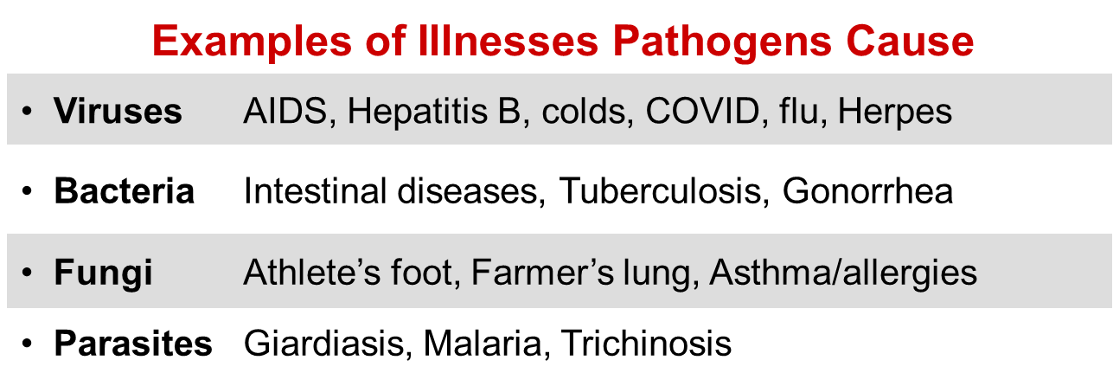
General Overview
PATHOGEN: a microorganism that can cause disease

Slide 4



Transmission of diseases
Organisms can enter the body via:
Inhalation – airborne particles and droplets
Ingestion – contaminated food or beverages
Contact - bloodborne

Slide 5




Bloodborne pathogens (BBPs)

Slide 6

Bloodborne pathogens (BBpS)
saliva in dental procedures (if blood is present)
any body fluids visibly contaminated with blood
semen
vaginal secretions
body fluids such as pleural, cerebrospinal, pericardial, peritoneal, synovial, and amniotic
body fluid where it is difficult to differentiate
any unfixed tissue or organ (other than intact skin) from a human (living or dead)
HIV- or HBV-containing cultures (cell, tissue, or organ), culture medium, or other solutions
blood, organs, & tissues from animals infected with HIV, HBV, or BBPs

Slide 7


Transmission of BBPs
Bloodborne Pathogens can enter your body through:
a break in the skin (cut, burn, lesion, etc.)
mucus membranes (eyes, nose, mouth)
sexual contact
other modes

Slide 8

Transmission of bbps
The pathogen involved
The type/route of exposure
The amount of virus in the infected blood at the time of exposure
The amount of infected blood involved in the exposure
Whether post-exposure treatment was taken
Specific immune response of the infected individual

Slide 9
Injury report cont.
Some examples of bloodborne pathogens:
Malaria
Syphilis
Brucellosis
Leptospirosis
Arboviral infections
Relapsing fever
Creutzfeld-Jakob Disease
Viral Hemorrhagic Fever
Main bloodborne pathogens and diseases of concern
• Hepatitis B Virus (HBV) | • Hepatitis B
• Hepatitis C Virus (HCV) | • Hepatitis C
• Human Immunodeficiency Virus (HIV) | • AIDS

Slide 10
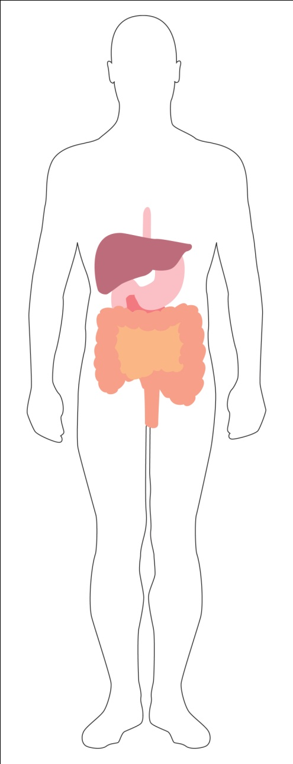
Viral hepatitis – general overview
The liver is a located in the upper right abdomen behind the lower ribs. It functions in removing toxins (poisons) from the blood, in the digestion of fats, and in other body processes.
Virus attacks liver causing inflammation, enlargement, and tenderness
Acute and chronic infections
Possible liver damage ranging from mild to fatal

Slide 11
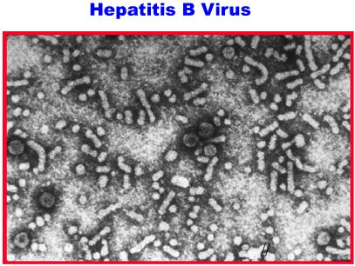
HBV - Hepatitis B
General Facts
Hearty - can live for 7+ days in dried blood
100 times more contagious than HIV
Approximately 78,000 new infections per year (2001)
1.25 million carriers
5,000 deaths/year
No cure, but there is a preventative vaccine

Slide 12
HBV - Hepatitis B
General Facts
Sharing needles during injecting drug use
From infected mother to child during birth
Sharps/needle sticks
Unprotected sex with multiple partners

Slide 13
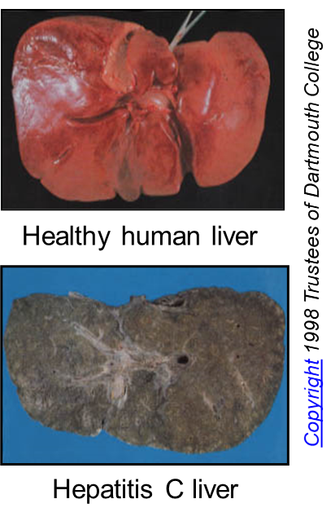
HBV - Hepatitis C
General Facts
The most common chronic bloodborne infection in the U.S.
3.9 million (1.8%) Americans infected; 2.7 million chronically infected
25,000 new infections per year (2001)
Leading cause of liver transplantation in U.S.
8,000-10,000 deaths from chronic disease/year
Treatment is expensive
No vaccine available
A healthy human liver contrasted with a liver from an individual who died from hepatitis C. Note the extensive damage and scarring from chronic liver disease.

Slide 14
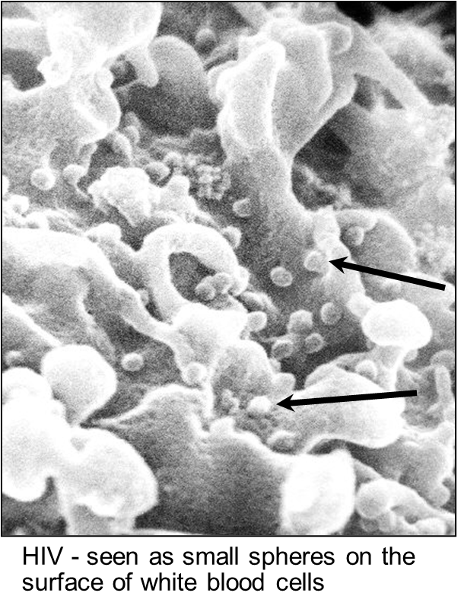
Human Immunodeficiency virus (HIV)
General Facts
Fragile – few hours in dry environment
Attacks the human immune system
Cause of AIDS
>1 million infected persons in U.S.
No cure; no vaccine available yet

Slide 15

Transmission of bbps
Occupational Exposure
means reasonably anticipated skin, eye, mucous membrane, or parenteral (piercing of the skin) contact with blood or OPIM that may result from the performance of an employee's duties
Exposure Incident
is a specific contact with blood or OPIM that is capable of transmitting a bloodborne disease

Slide 16


Exposure control Plan
To eliminate/minimize your risk of exposure
Exposure determination
Exposure controls
Training and Hazard Communication
Hepatitis B Vaccine
Post exposure evaluation & follow-up
Recordkeeping

Slide 17

Exposure controls
Reducing your risk
Universal precautions
Equipment and Safer Medical Devices
Work practices
Personal protective equipment
Housekeeping
Laundry handling
Hazard communication - labeling
Regulated Waste

Slide 18
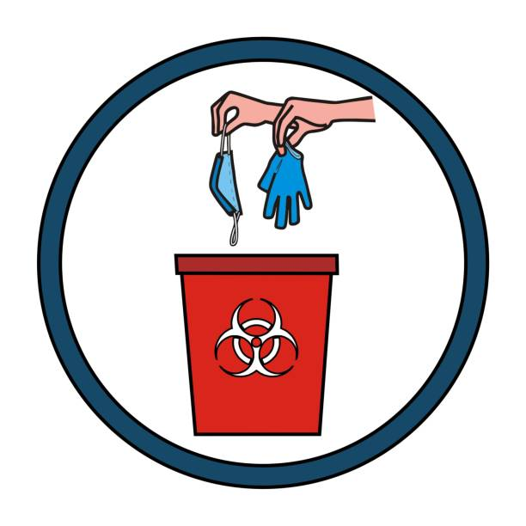
Exposure controls
Universal Precautions
A system of infection control:
TREAT ALL HUMAN BLOOD AND OPIM AS IF KNOWN TO BE INFECTIOUS WITH A BLOODBORNE DISEASE.

Slide 19

Exposure controls
Safe Work Practices
Do not eat, drink, smoke, apply cosmetics or lip balm, or handle contact lenses in any work areas where there is the possibility of exposure to blood or OPIM.
Do not place food or drink in refrigerators, freezers, shelves, cabinets, or on countertops or bench tops in any work areas.

Slide 20

Exposure controls
Safe Work Practices
Clean-up of spills and broken glassware/sharps contaminated with blood or OPIM
Wear protective eyewear and mask if splashing is anticipated.
Remove glass and other sharps materials using a brush and dustpan, forceps, hemostat, etc. Do not use your hands.
Properly discard all materials into a sharps or puncture-resistant biohazardous waste container.
Use paper/absorbent towels to soak up the spilled materials.

Slide 21

Exposure controls
Safe Work Practices
Clean-up of spills and broken glassware/sharps (cont.)
Clean the area with 10% bleach or EPA-registered disinfectant.
Saturate the spill area with disinfectant. Leave for 10 minutes (or as specified by product manufacturer) or allow to air dry.
Properly dispose of paper towels and cleaning materials into proper waste containers.

Slide 22
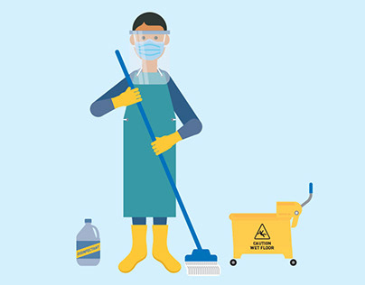
Exposure controls
Personal Protective Equipment (PPE)
You must wear all required PPE. Interstate Corporation provides you with the following PPE at no cost:
Face shields or
Masks and eye protection
Resuscitation devices
Gloves
Lab coats
Gowns
Shoe covers

Slide 23
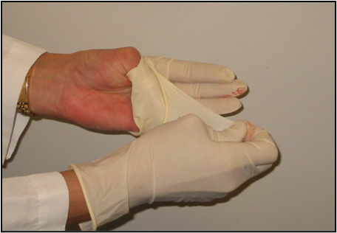
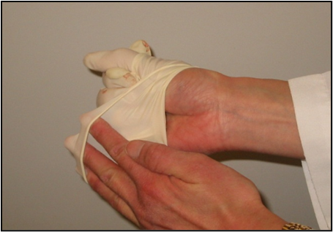
Exposure controls
Personal Protective Equipment (PPE)
Remove gloves safely and properly
Grasp near cuff of glove and turn it inside out. Hold in the gloved hand.
Place fingers of bare hand inside cuff of gloved hand and turn inside out and over the first glove.
Dispose gloves into proper waste container.
Clean hands thoroughly with soap and water (or antiseptic hand rub product if handwashing facilities not available).

Slide 24

Exposure controls
Housekeeping
Maintain a clean and sanitary workplace
Written cleaning and decontamination schedule and procedures
Approved disinfectant – bleach, EPA-approved
Contaminated waste disposal methods
Laundry

Slide 25
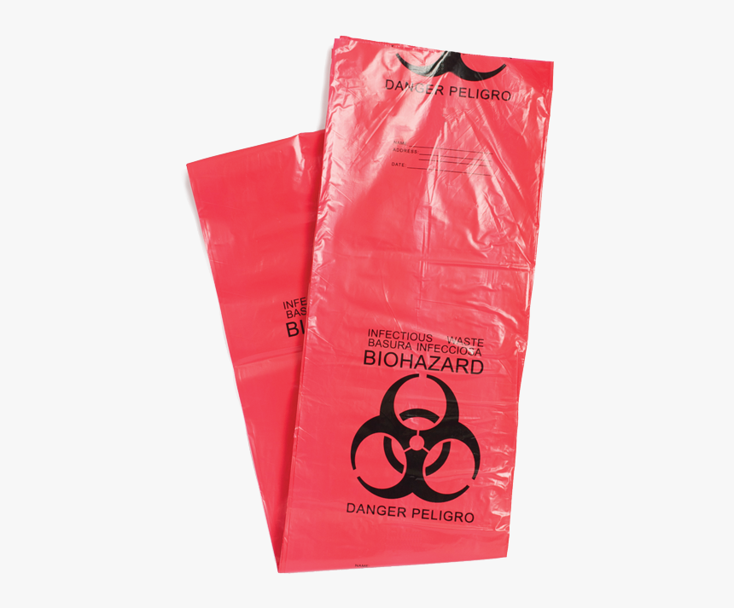
HBV - Hepatitis C
Laundry
Contaminated articles
Handle as little as possible
Bag/containerize where used
Don’t sort or rinse where used
Place in leak-proof, labeled or color-coded containers or bags
Wear PPE when handling and/or sorting:
Gloves
Gown

Slide 26
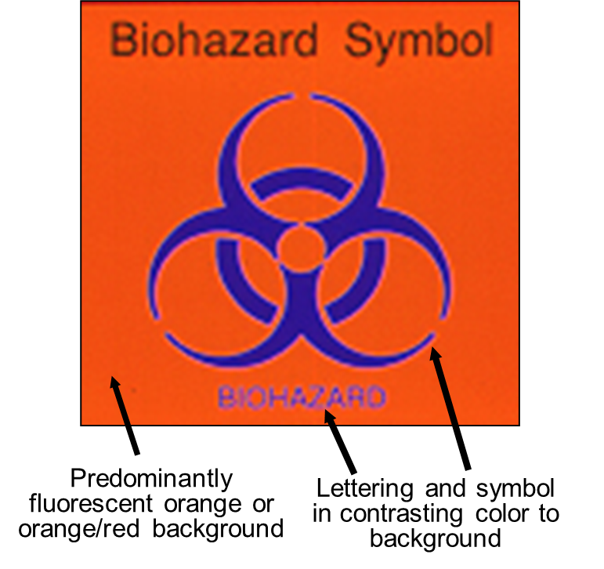
Exposure controls
Communication of Hazards
Biohazard Labels and Signs
Must have biohazard symbol
Labels attached securely to any containers or items containing blood/OPIM
Red bags/containers may substitute for labels
Signs posted at entrance to specified work areas

Slide 27

Exposure controls
Regulated Waste
Liquid or semi-liquid blood or OPIM
Contaminated items that would release blood or OPIM in a liquid or semi-liquid state if compressed
Items caked with dried blood or OPIM that can release these materials during handling
Contaminated sharps
Pathological and microbiological wastes containing blood or OPIM

Slide 28
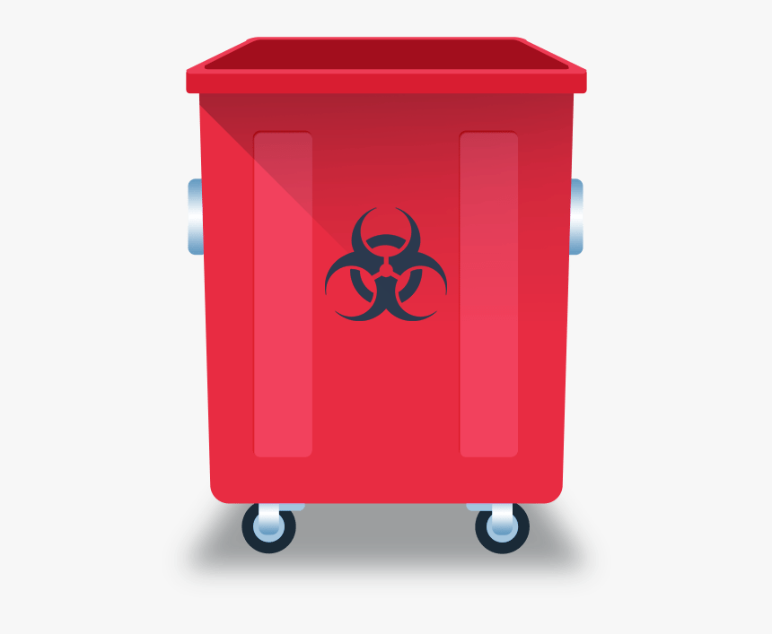
Exposure controls
Regulated Waste - Containers
Easily accessible
Labeled or color-coded
Leak-proof, closeable
Puncture-resistant for sharps
Replaced routinely (do no overfill!)

Slide 29
Exposure controls
Regulated Waste - Containers
Close immediately before removing or replacing
Place in second container if leaking possible or if outside contamination of primary container occurs
If reusable, open, empty, and clean it in a manner that will not expose you and other employees

Slide 30

Hepatitis B vaccine
3 shots: 0, 1, & 6 months
Effective for 95% of adults
Post-vaccination testing for high risk HCW
Post-exposure treatment (if not vaccinated)
Immune globulin
Begin vaccination series
If decline, must sign Declination Form
vaccine available at later date if desired

Slide 31
Exposure incident
If you have an exposure incident to blood or OPIM, immediately do the following:
Thoroughly clean the affected area
• Wash needlesticks, cuts, and skin with soap and water
• Flush with water splashes to the nose and mouth
• Irrigate eyes with clean water, saline, or sterile irrigant
Report exposure to manager and fill out an
Incident Report Form

Slide 32
Post exposure evaluation
Interstate’s Responsibility:
Provide immediate post-exposure medical evaluation and follow-up to exposed employee:
No cost
Confidential
Testing for HBV, HCV, HIV
Preventive treatment when indicated
Test blood of source person if HBV/HCV/HIV status unknown, if possible; provide results to exposed employee, if possible

Slide 33
Post Exposure evaluation
Interstate’s Responsibility: (cont.)
Provide exposed employee with copy of the evaluating health care professional’s (HCP) written opinion within 15 days of completion of evaluation
Provide employee with information about laws on confidentiality for the source individual
Provide post-exposure treatment as needed, including counseling

Slide 34

recordkeeping
Medical Records
Confidential
Hepatitis B vaccination and post-exposure evaluations
HCP’s written opinions
Information provided to HCP as required
Maintain for length of employment + 30 years

Slide 35

recordkeeping
Training Records
Dates
Content summary
Trainer name & qualifications
Attendee’s names & job titles
Maintain for 3 years

Slide 36
Questions

